Slide 1

Soldier Strap
Security and Surveillance

Slide 2
Domain Bucket : Security and Surveillance Category : Hardware Organization : Dte of IT and cyber security, DRDO Problem Code : CK48 Team Name : The Improvisers Team Leader Name : Tejas Phalod College Code : C-19946
IDEA
Most of the soldiers are using very basic gadgets for communication purposes. In this smart digital world they are in a dire need of upgradation. They need something advanced, simple and versatile .
This project aims for advancement in communication and surveillance system by designing a gadget which is fast, versatile and user friendly.
Our product is a tracker which monitors a soldier’s geolocation and vital health parameters and keeps the base updated about their activities.

Slide 3
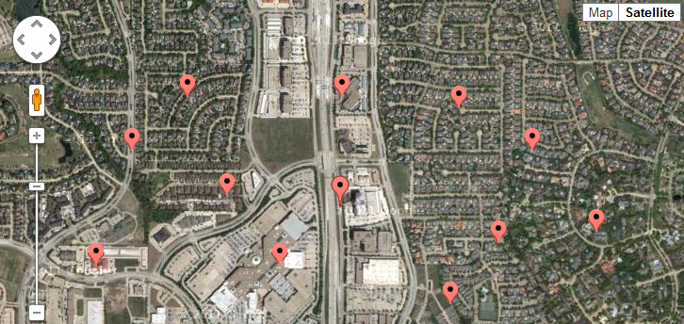
SOLUTION
Our product is a strap which tracks the
movements of soldiers using GPS functionality
to maintain a proper location timeline.
It records vital body parameters such
as- heart rate, temperature and oxygen content.
Pre-programmed buttons are provided for quick communication among the soldiers and the base camp.
MANET type communication makes the device independent of any satellite for communication.

Slide 4
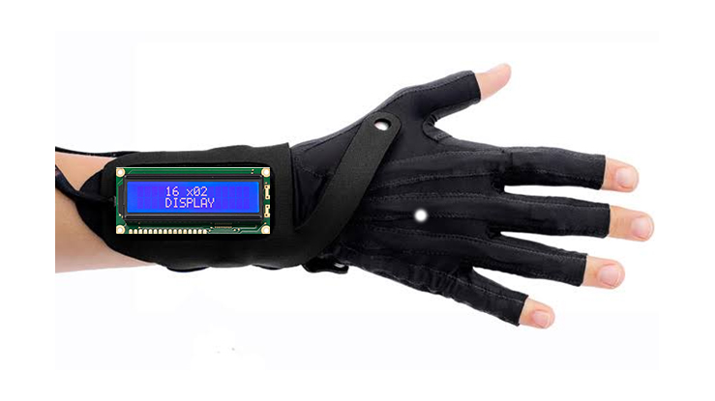
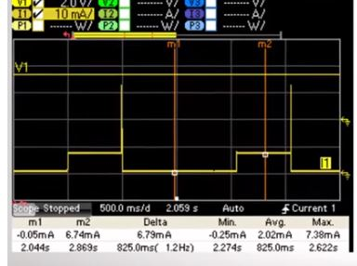
The soldier has to login every 24 hours to confirm his identity and make sure that he is the one operating the device.
LCD display provided makes the strap very easy to operate and helps in reading the message transmitted by the base or a nearby soldier in need.
The device will be having a timer for operating it for a designated time period and then put the device into sleep mode to save battery.
The data gathered will be uploaded to the cloud from the base camp.

Slide 5
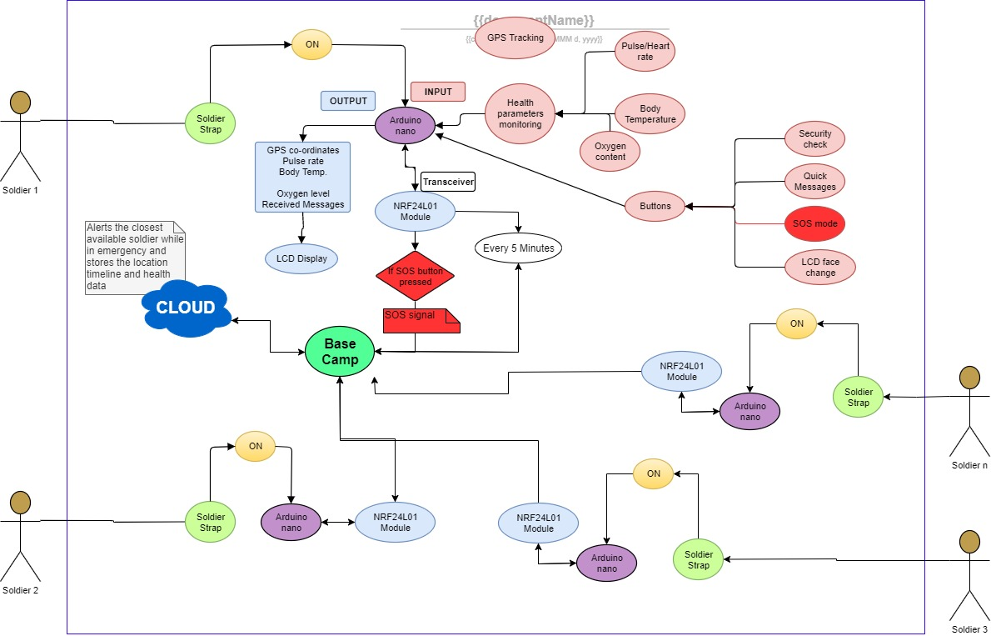
USE CASE DIAGRAM

Slide 6
TECHNOLOGY STACK
Microcontrollers
Arduino nano
Sensors and Modules
Sensors: Pulse, Oximeter, Temperature
Modules: NRF24L01, GPS, GSM
Database
Google firebase
Language
C++
Communication
MANET
Public network (backup for emergency cases)

Slide 7
DEPENDENCIES
Google Maps
SHOW STOPPER
No firewall for MANET communication, hence security features are constraint.
Ideas are being implemented to make the device secure
TEAM:
Tejas
Mayank Jain
Rajath Pathak
Shreya
Varun
Pranay

